Slide 1

SWP391: FINAL PROJECT PRESENTATION
SALE MANAGEMENT SYSTEM

Slide 2
Project Overview
Members
Vũ Nam Khánh
Nguyễn Vũ Hùng
Chúc Kim Anh
Nguyễn Trung Kiên

Slide 3
Project Overview
Project Introduction
The Sales Management Software is a web-based application developed for retail and wholesale convenience stores to manage daily business operations. The system supports sales, customer management, inventory management, employee management, financial management, and business reporting.
The system is developed using Spring Boot, Thymeleaf, MySQL, and follows the MVC architecture.

Slide 4
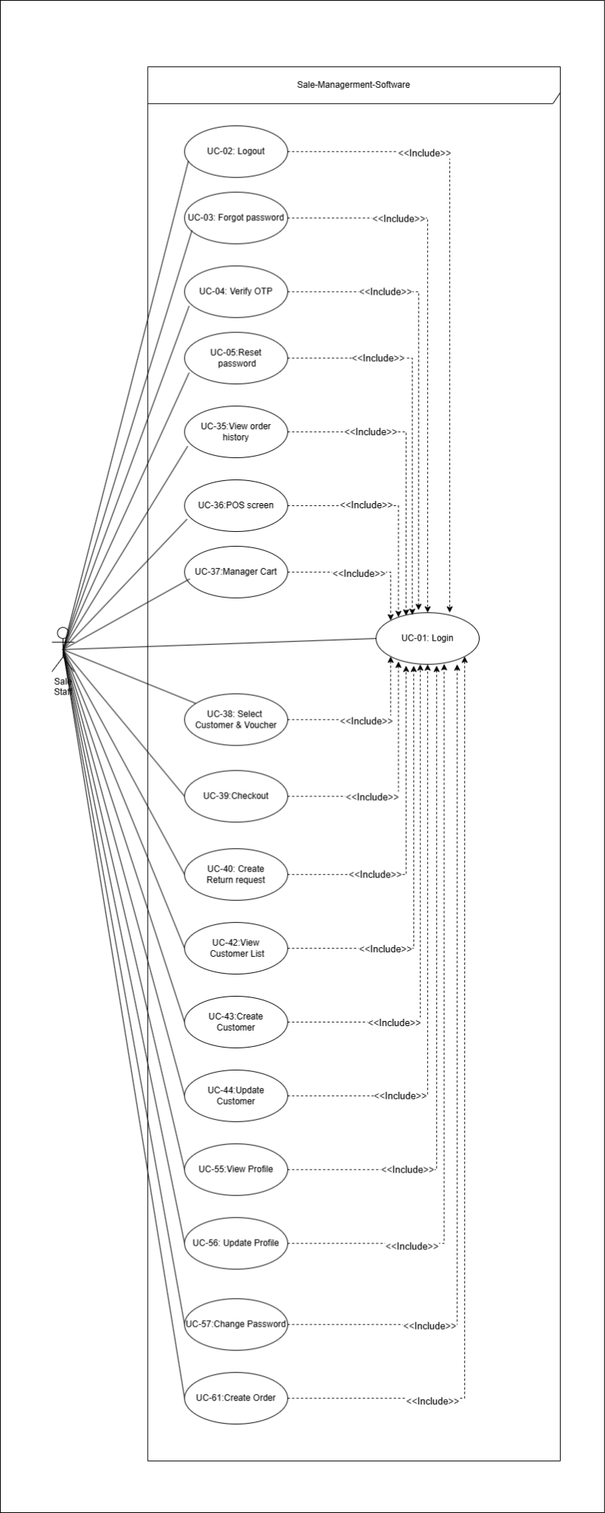
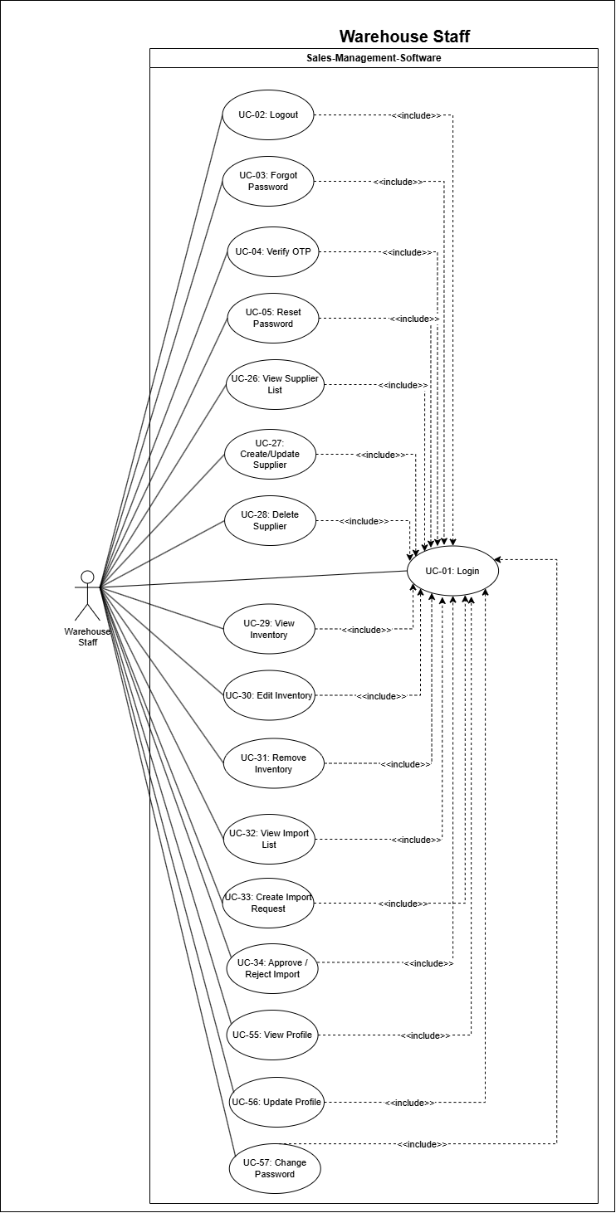
Product Requirements Use Case Diagrams
UCs for Sale Staff & Warehouse Staff

Slide 5
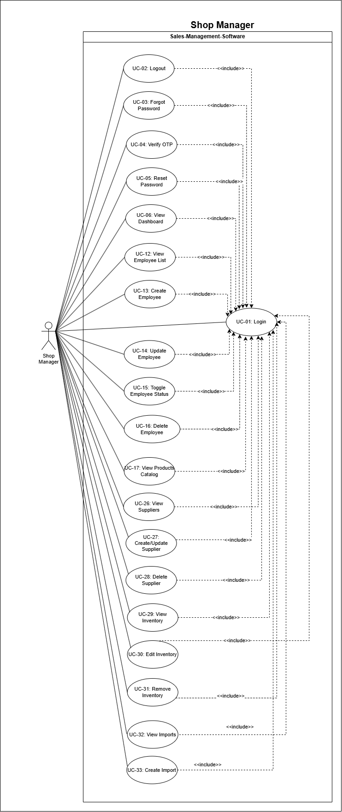

Product Requirements Use Case Diagrams
UCs for Shop Management

Slide 6

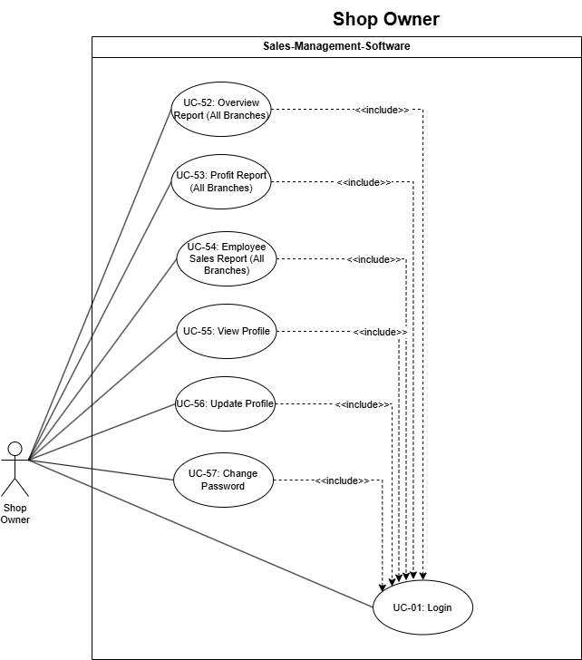
Product Requirements Use Case Diagrams
UCs for Shop Owner

Slide 7
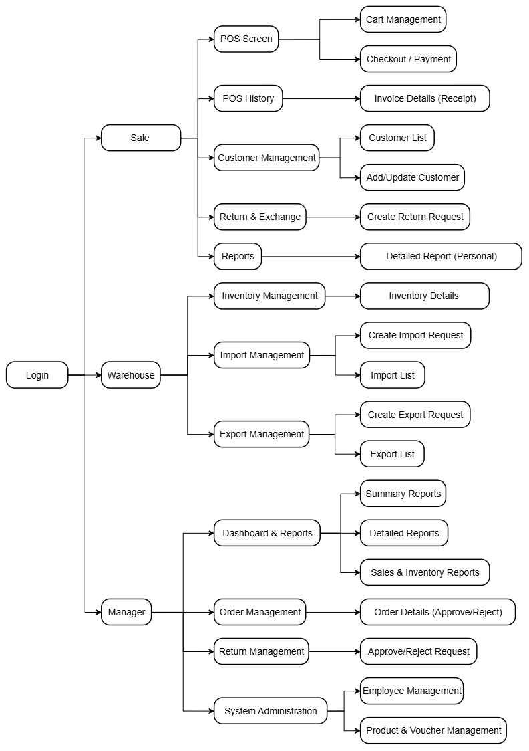
Product Requirements Product Functionalities
Screen flow for all the screens

Slide 8
Product Requirements Main Screen UI Design
Provide screenshot(s) for the main screens that you have completed
Main Web screen: Home Page or Landing Page
Main Admin screen: Dashboard (if any)

Slide 9
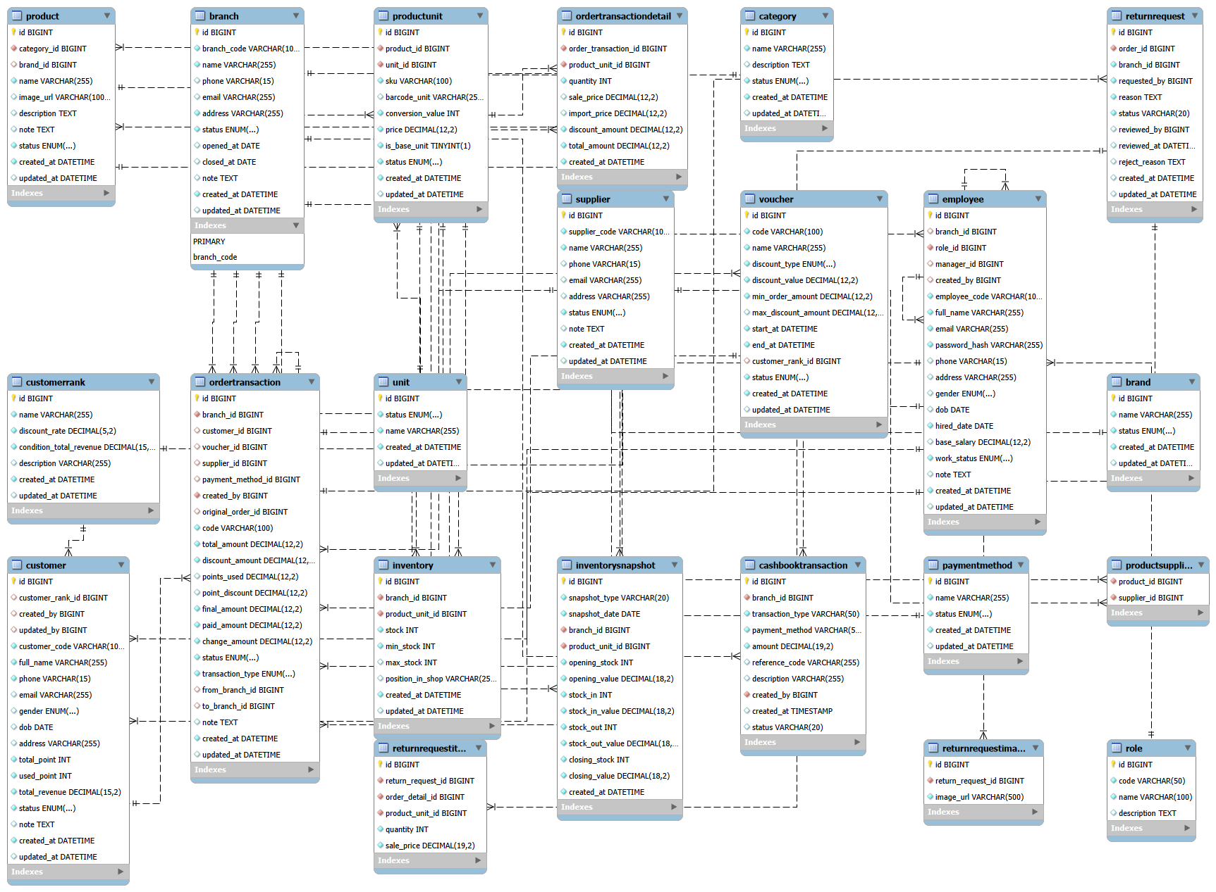
System Design Database Design
Database schema

Slide 10
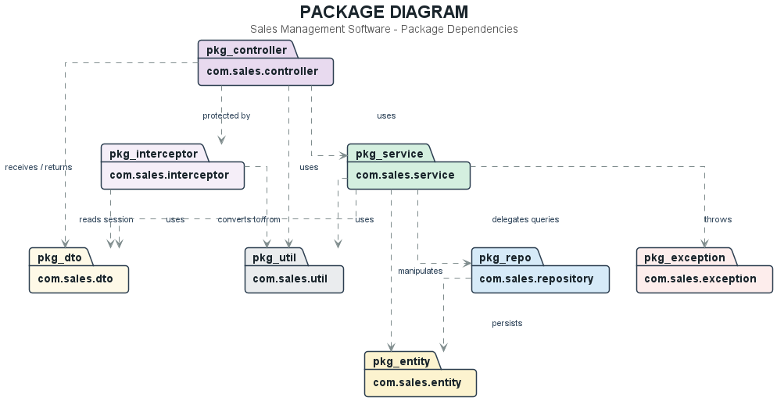
System Design Package Diagram
System package diagram

Slide 11
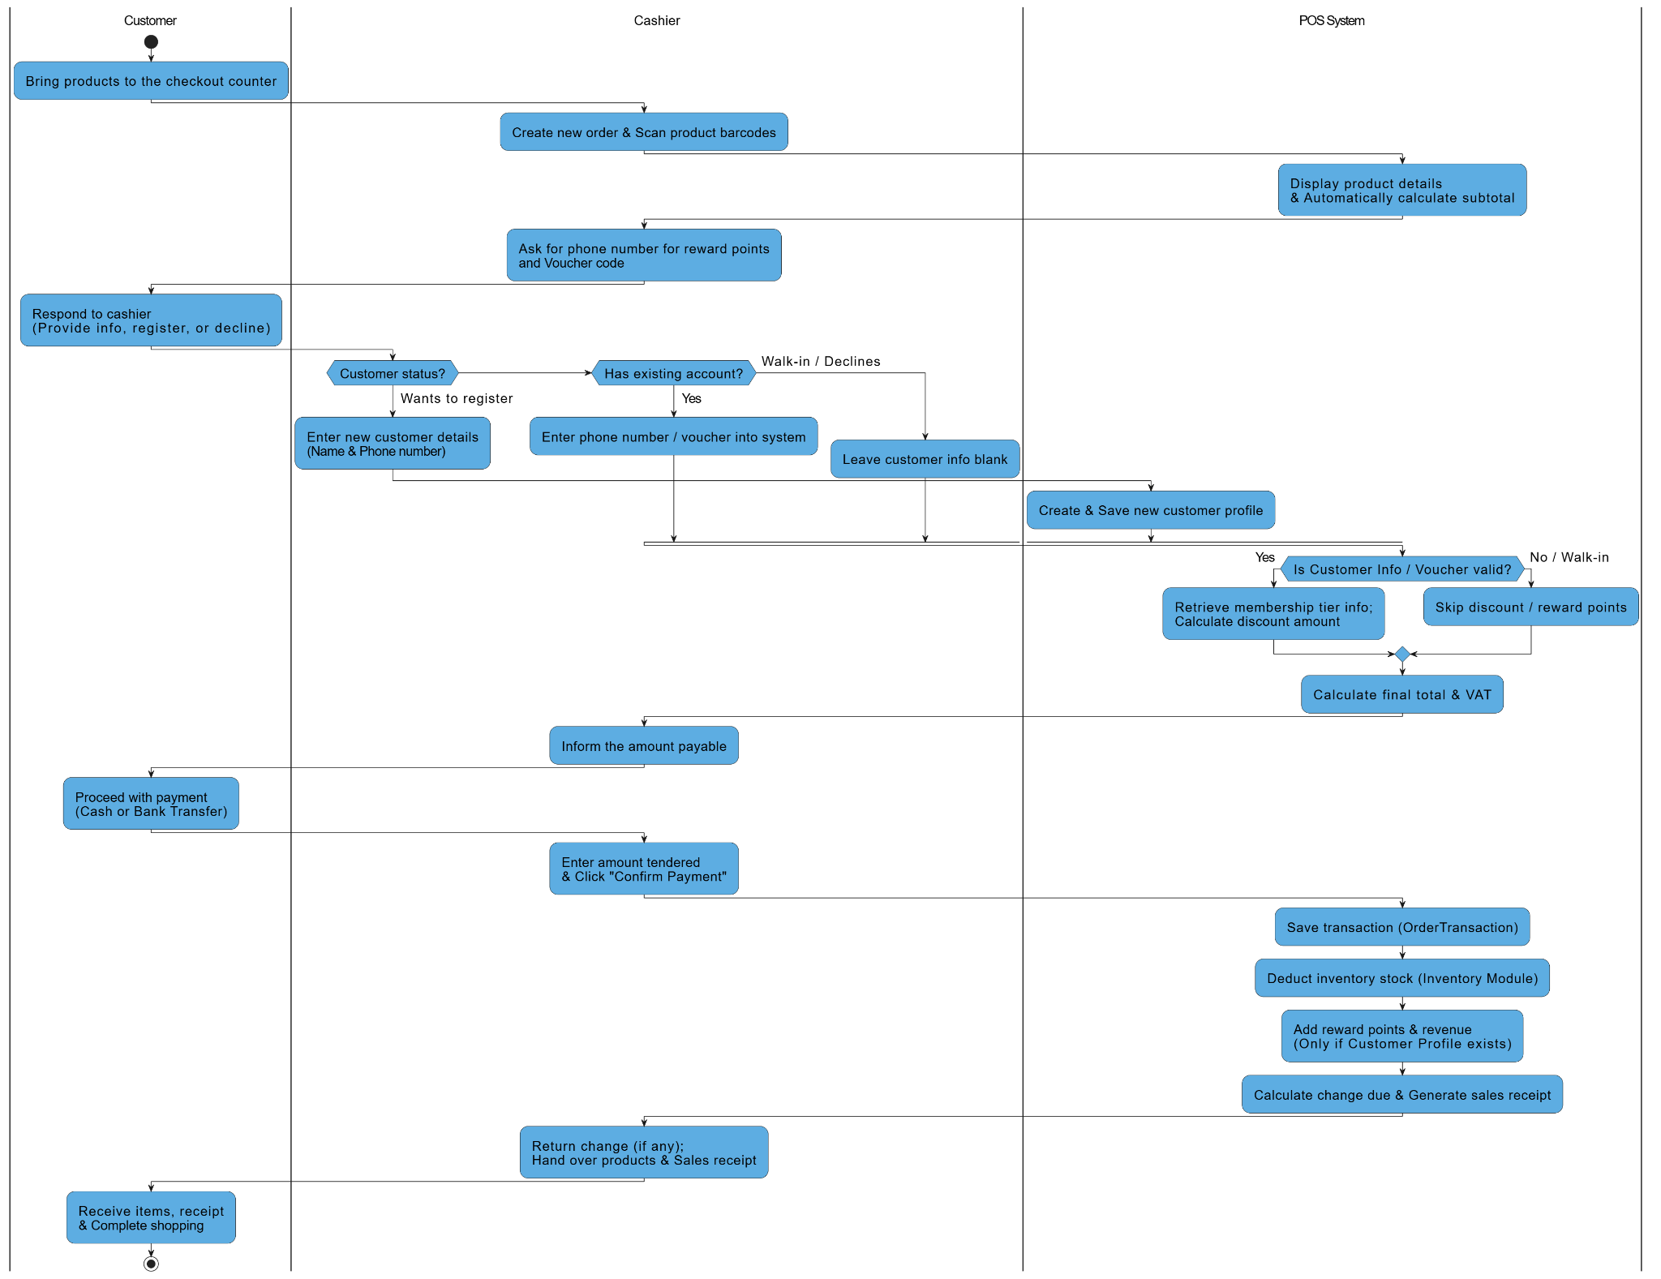
Demonstration

Slide 12
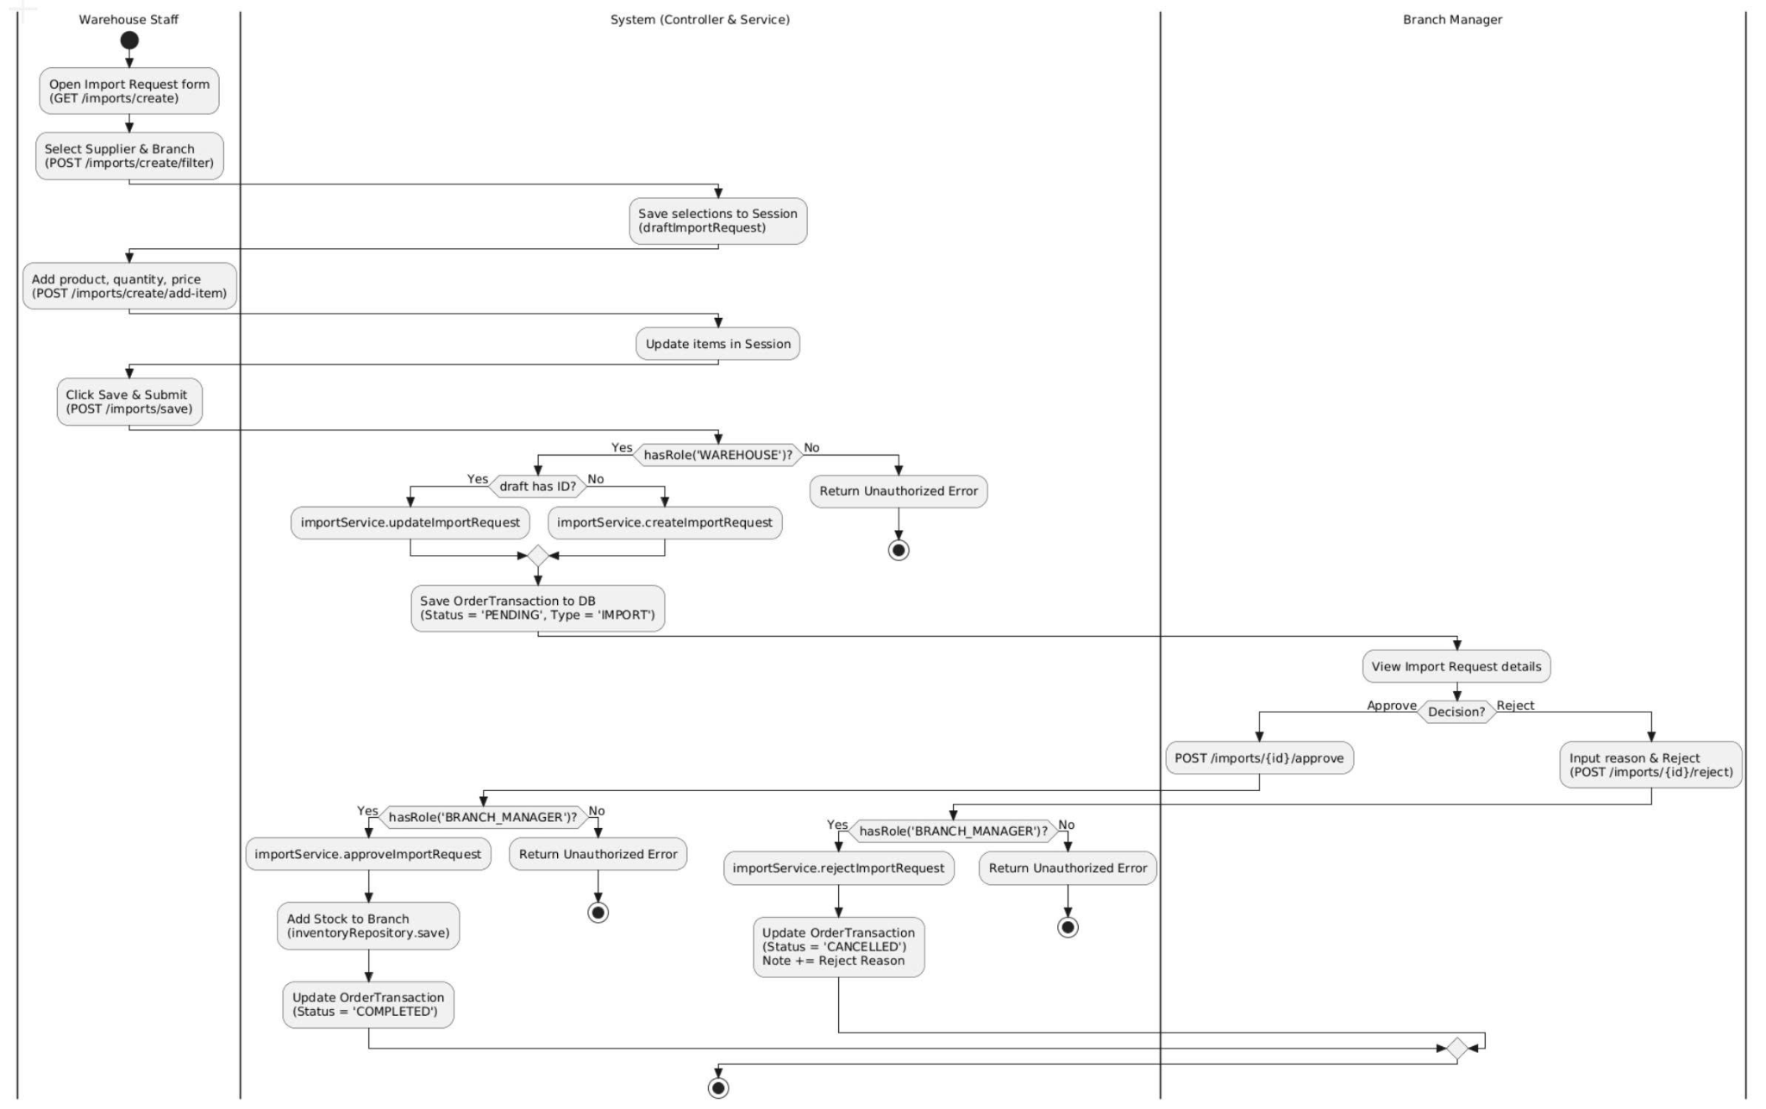
Demonstration
Import Product

Slide 13
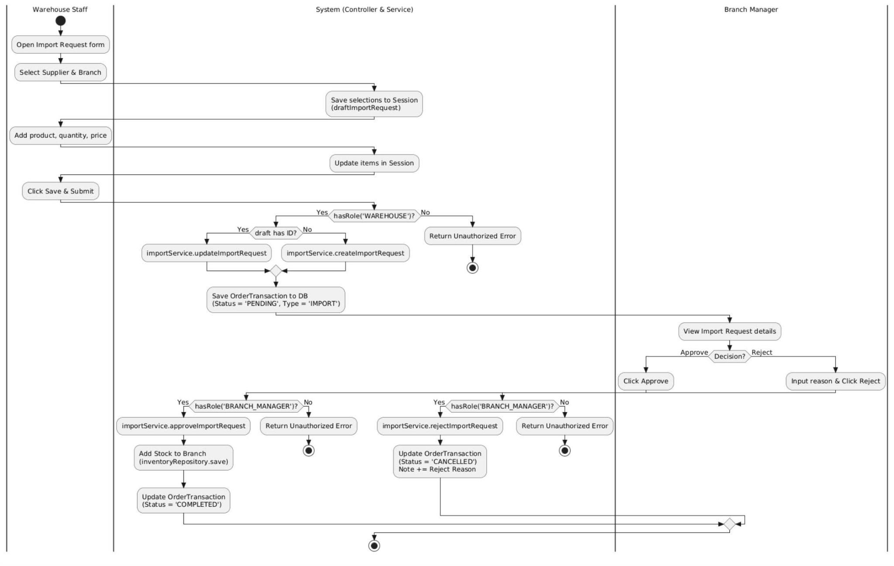
Demonstration
Transferring inventory between branches

Slide 14
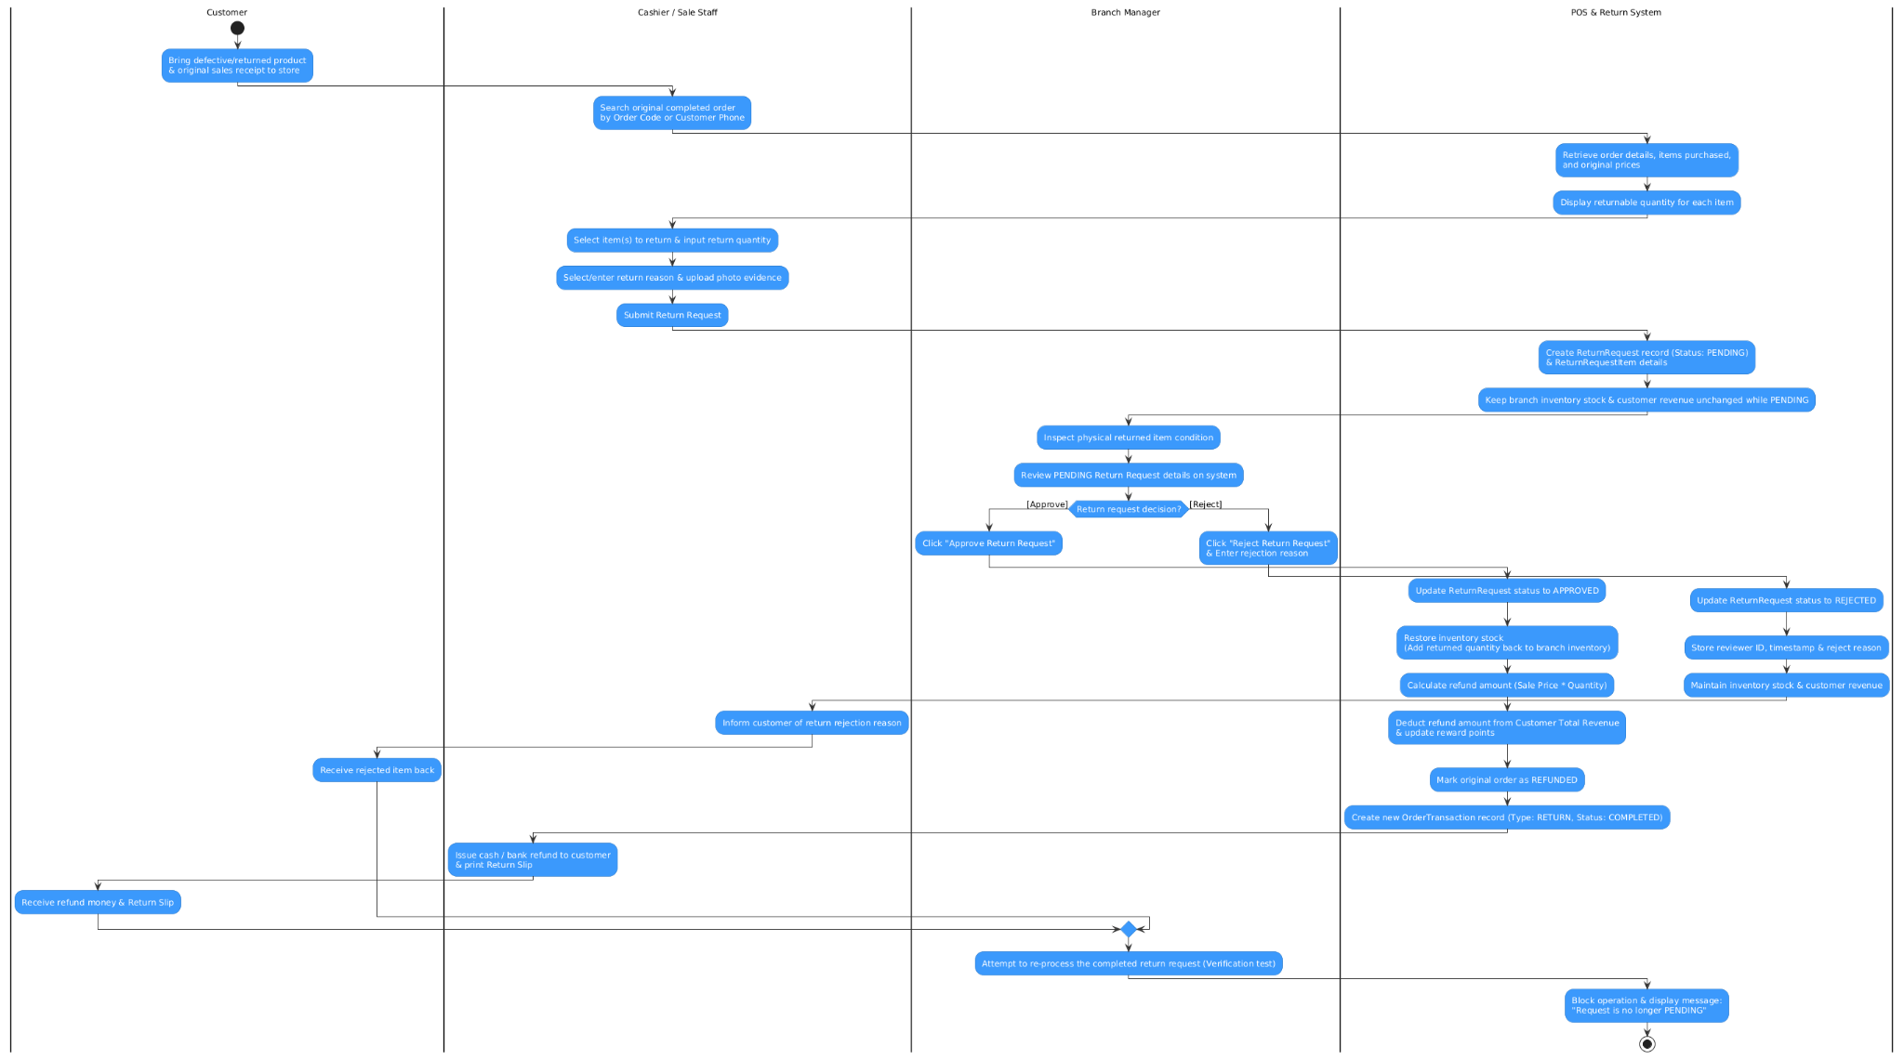
Demonstration

Slide 15


